Slide 1
IBD PATIENT AMBASSADOR PROGRAM
PRESENTED BY: Nidhi Swarup

Slide 2
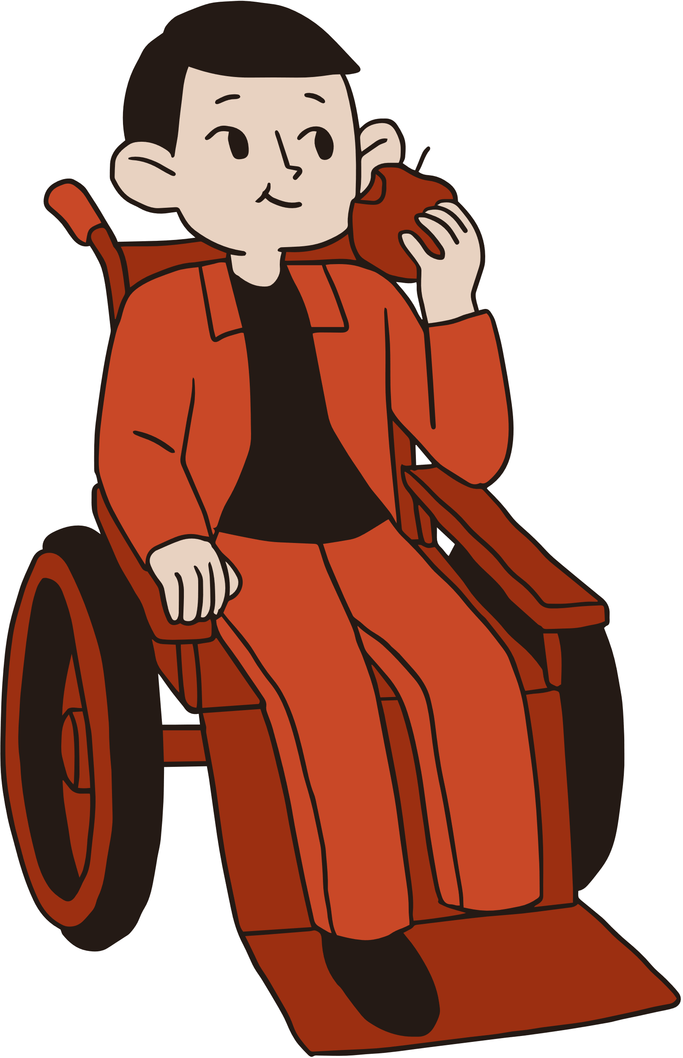
IBD PATIENT AMBASSADOR PROGRAM
Today's Briefing
#1 PURPOSE
#2 VENUE
#3 FOCUS
#4 COST
#5 HUDDLE

Slide 3
PEER SUPPORT
A Patient Understands Another's Challenges
For a newly diagnosed IBD Patient, it is very confusing and scary. No Cure, No known Cause, Lifelong Medicines, Threat of Random Flare-up of symptoms, etc
For any IBD Patient, Hospitalization at any time is not easy: a visit by another IBD Patient is meaningful.
PURPOSE

Slide 4
VIDEO TRAINING MODULES
Each one of us comes with a different experience, skills set, and knowledge about IBD. To provide basic knowledge about IBD, we have created a set of five training videos. Presentations by IBD Specialist, Nurse, Medical Social Worker (MSW), Pharmacist, and Dietician
Videos will be uploaded to CCSS Website. Only registered volunteers will have access via Username & Password
Learn at your own pace!
VIDEO TRAINING MODULES

Slide 5
VENUE: NUH

Slide 6
VOLUNTEER MATCHING
Indicate you preferred days and time.
Each volunteer can fill-up the Volunteer Application Form. Indicate your availability based on weekday or weekend to visit NUH. Add your preferred time slot
One year pilot program.
NUH Nurse & CCSS will co-ordinate in the background
volunteer placement

Slide 7
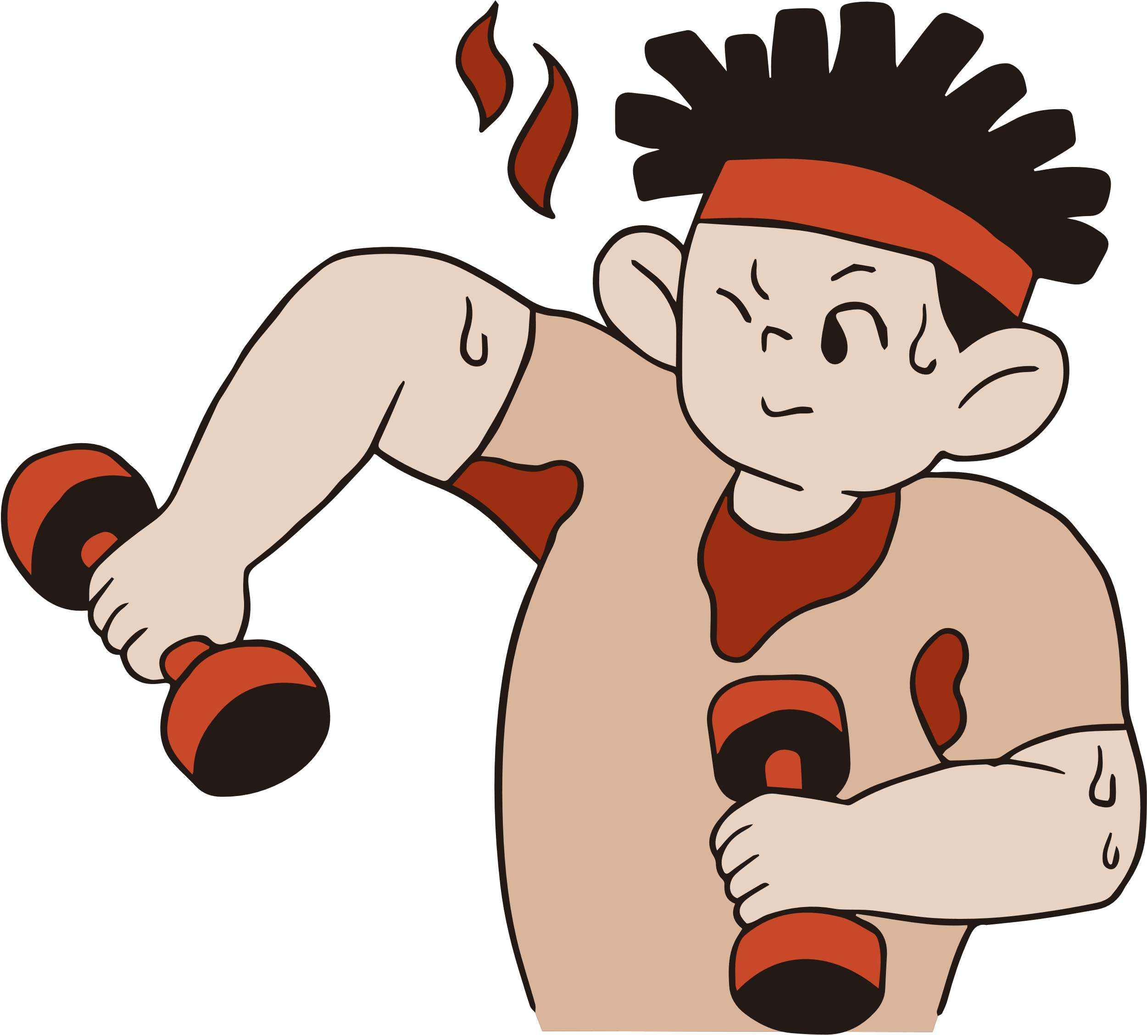
FOCUS ADULT IBD PATIENTS

Slide 8
ABOVE 18YEARS
Adult IBD Patients
We are reaching out to Adult IBD Patients for now.
For now, our outreach and support is targeted at IBD Patient that are above 18 years old. Although NUH has a Pediatric IBD Unit, we are starting with adults only. All training is in this area

Slide 9
REIMBURSEMENTS

Slide 10
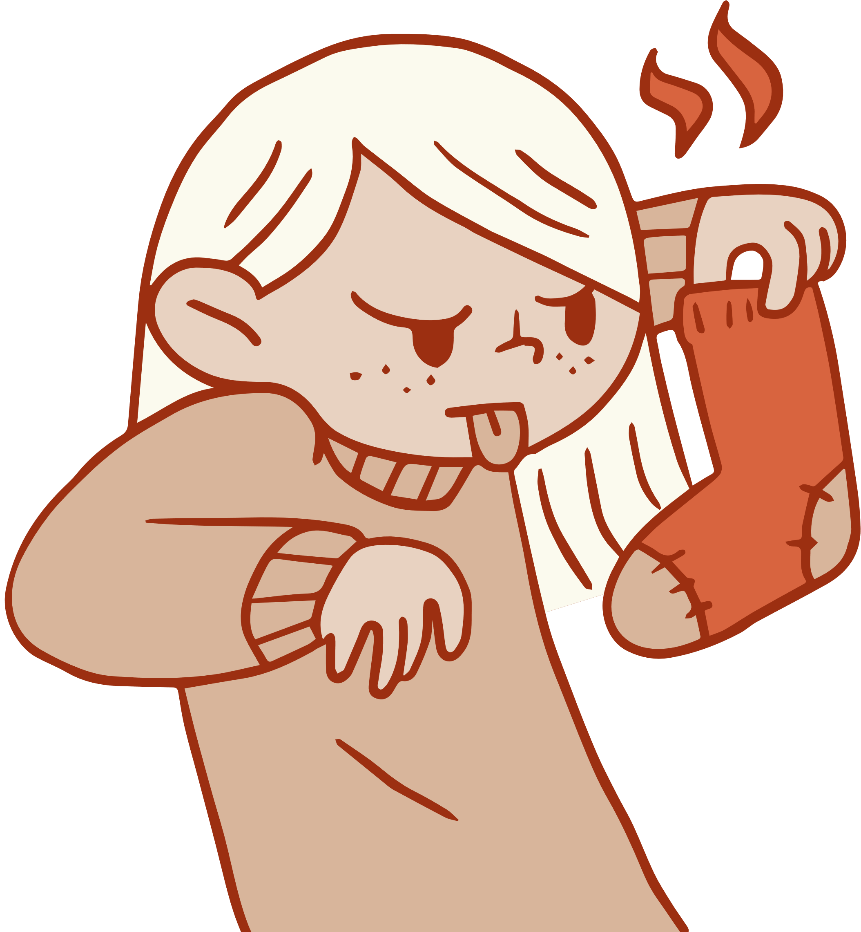
TRAVEL + REFRESHMENTS
Don't worry about added expenses.
CCSS will cover travel and refreshment expenses for each trip to support another IBD Patient. Budget $30 per visit. More details to follow
reimbursements

Slide 11
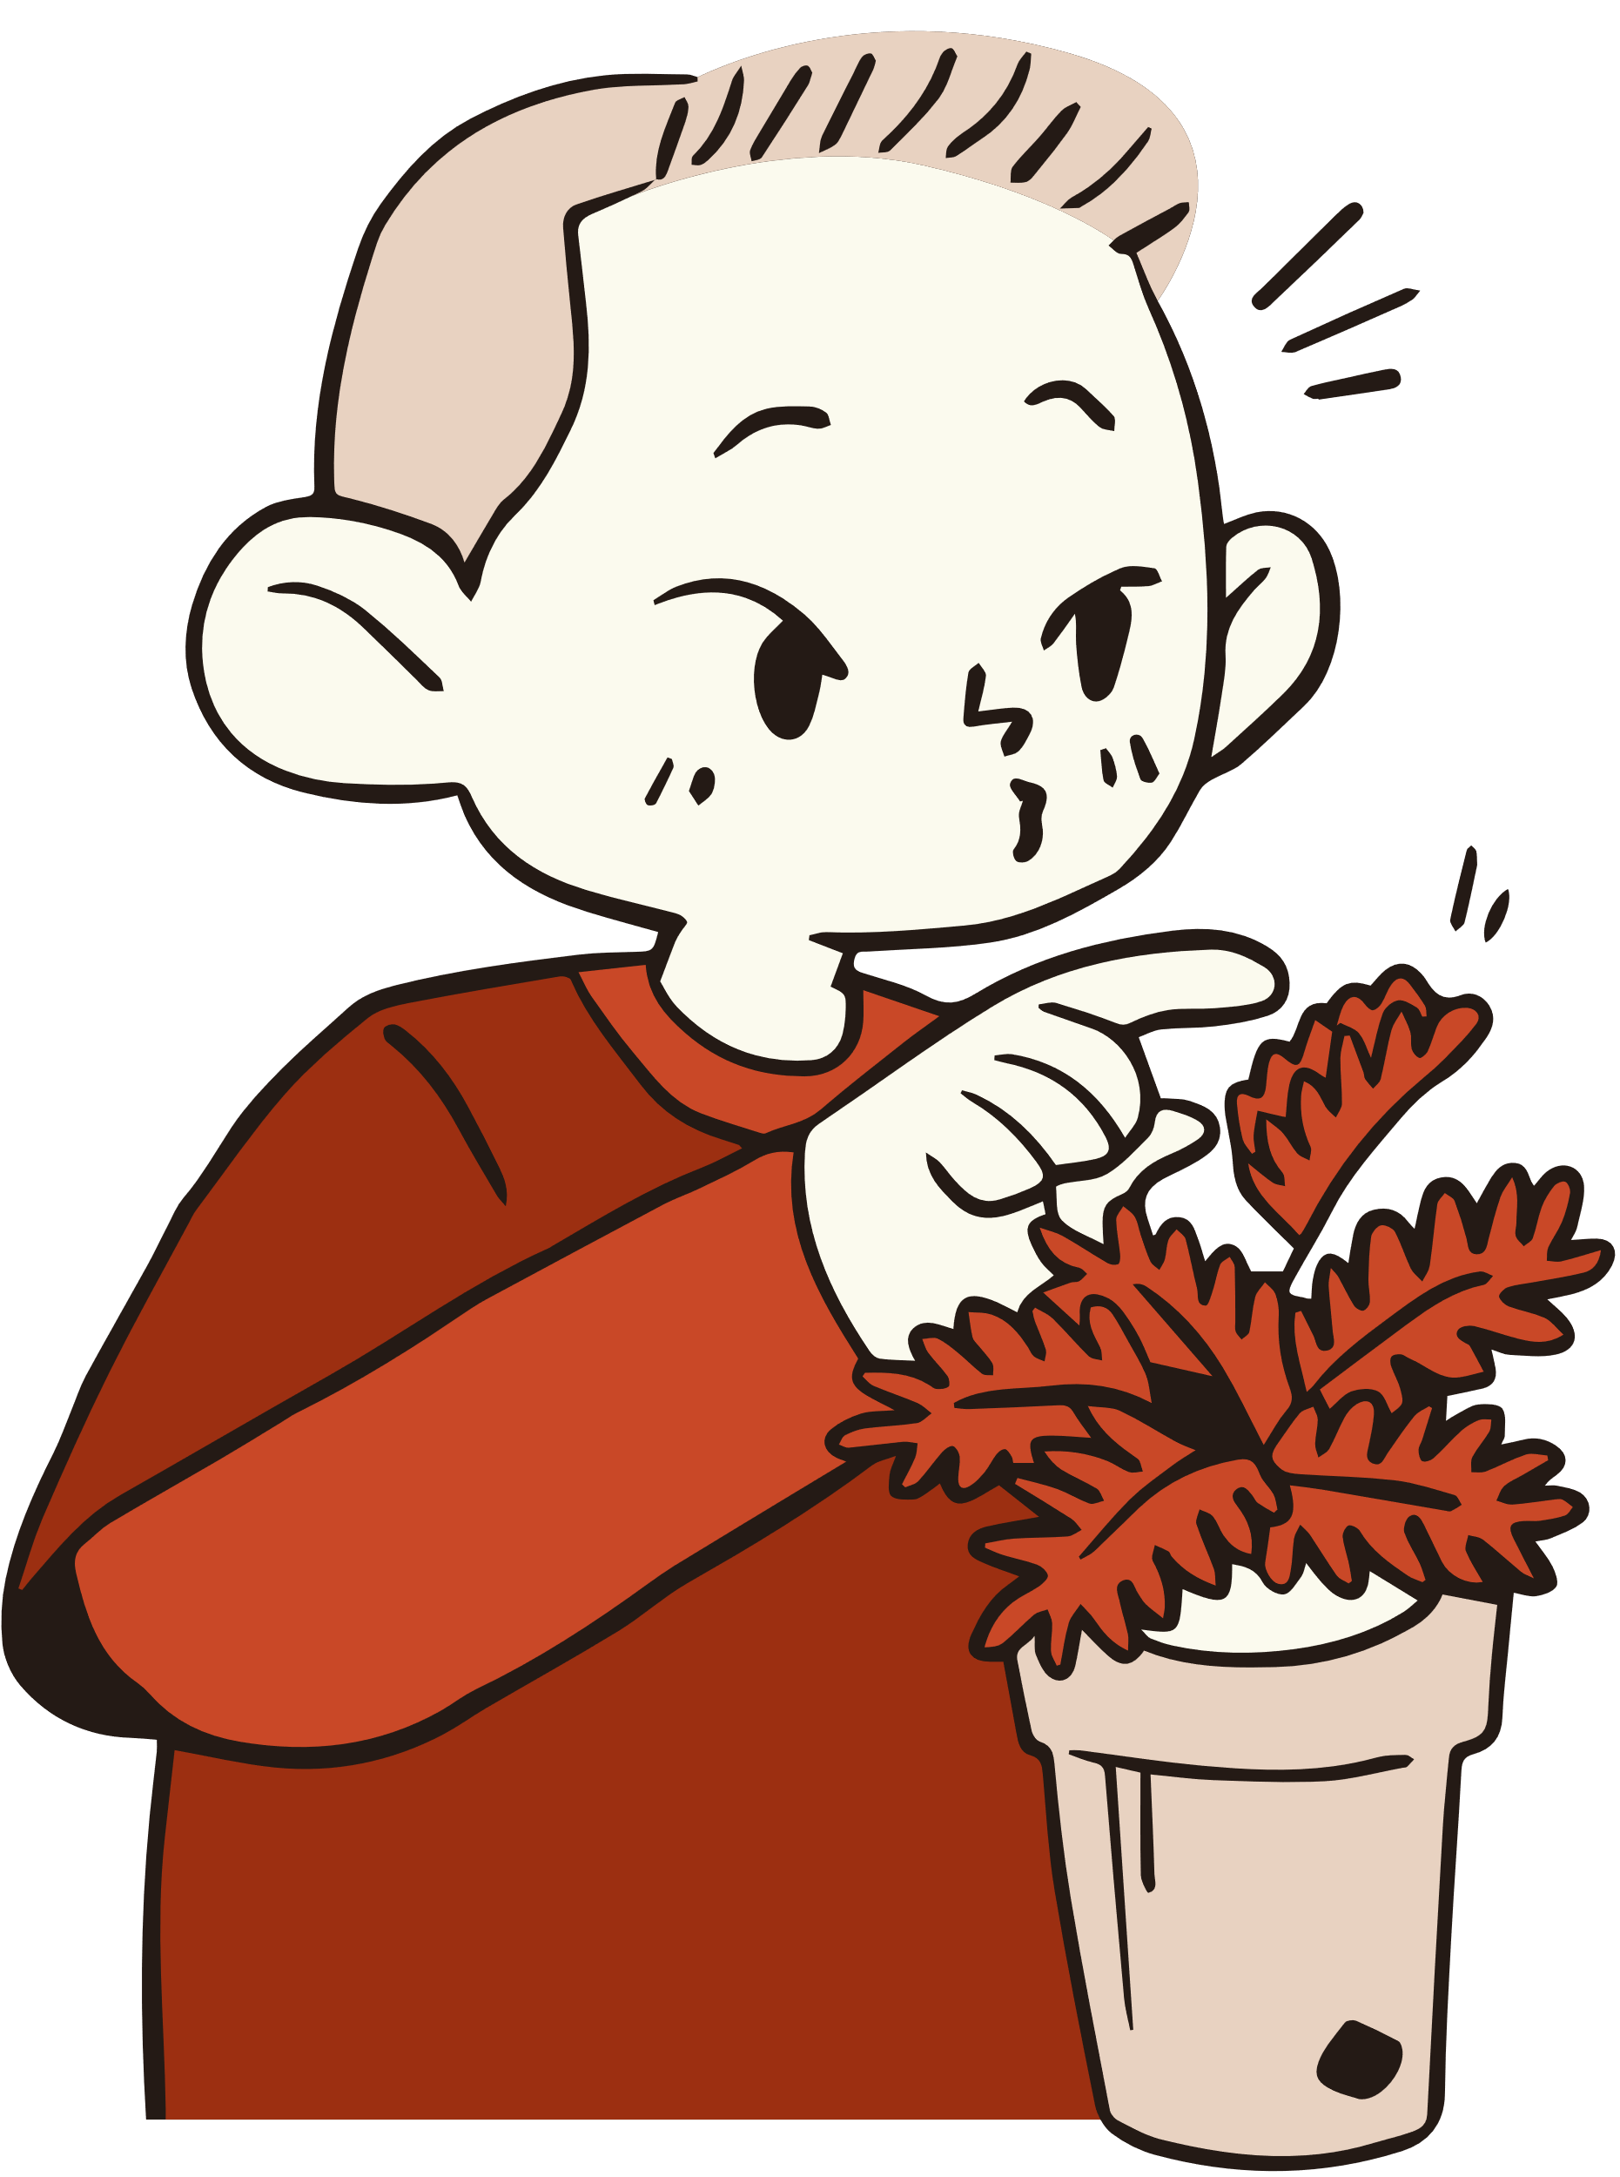
QUARTERLY HUDDLE

Slide 12
QUARTERLY MEAL WITH EXCO
Lunch/dinner @Restaurant: Review and Relax!
All volunteers and a few Executive Committee (EXCO) Members will come together to exchange success stories. It will also be an opportunity for you to share any challenge you might be facing while providing peer-support to other IBD Patients hospitalized at NUH
THE HUDDLE

Slide 13
THANK YOU FOR LISTENING

Slide 14
TIME FOR QUESTIONS!

